Slide 1
Before we get started…
For your research,
what is the frequency content of the signals you work with?
what is their amplitude?
how accurately do you need to measure the amplitude of a signal?
how accurately do you need to measure the phase of a signal?

Slide 2
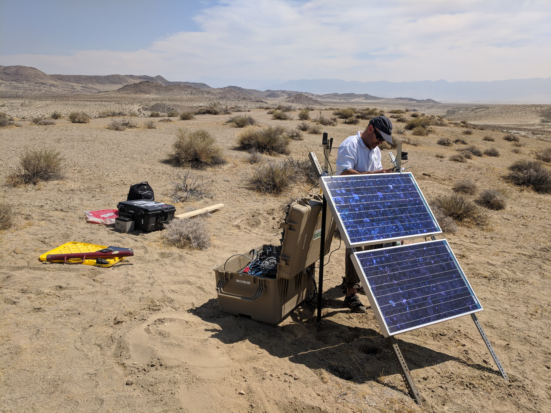
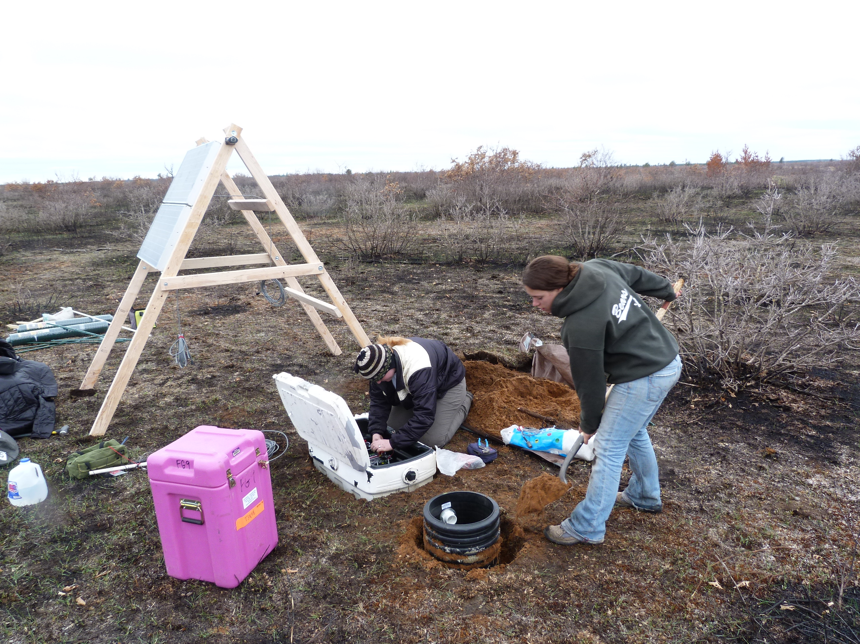


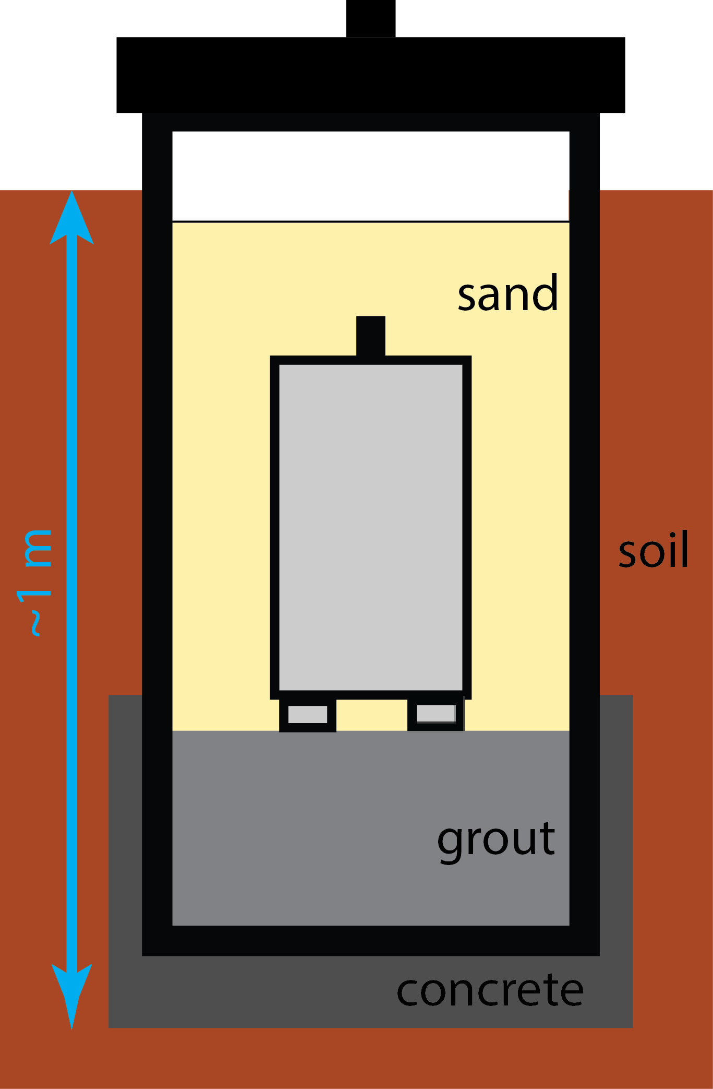
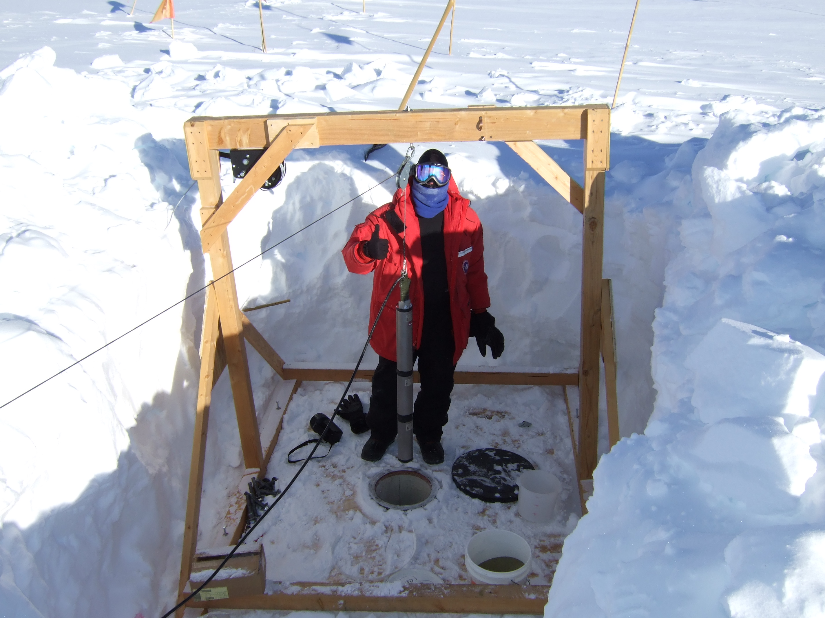
Instrumentation and metadata: a brief overview
Emily Wolin
USGS Albuquerque Seismo Lab
with material adapted from the Instrument Response Functions tutorial developed for USArray data processing course by Bob Woodward and Suzan van der Lee

Slide 3
Take-home points
Instrument responses are not a black box! They describe the process of taking a physical ground motion and converting it to a digital signal
Choose your processing parameters carefully – what do you need out of your data?
Understand the capabilities and limitations of the instrumentation you are working with
Seismic instrumentation literature can be dense and hard to read for non-specialists. I am always happy to answer your questions about metadata and instruments! ewolin@usgs.gov
We’re working on an SRL EduQuakes manuscript that discusses how to select the right instrumentation for your study: please let me know what you’d like to see!

Slide 4
Why do *you* need to think about instrumentation and metadata?
Seismology’s history of open data sharing = data from a wide variety of seismic instrumentation is readily available to you as a researcher
Important to choose the right tool for the job
Important to understand instruments’ capabilities and limitations
Need to use metadata to convert raw signals to physical units

Slide 5
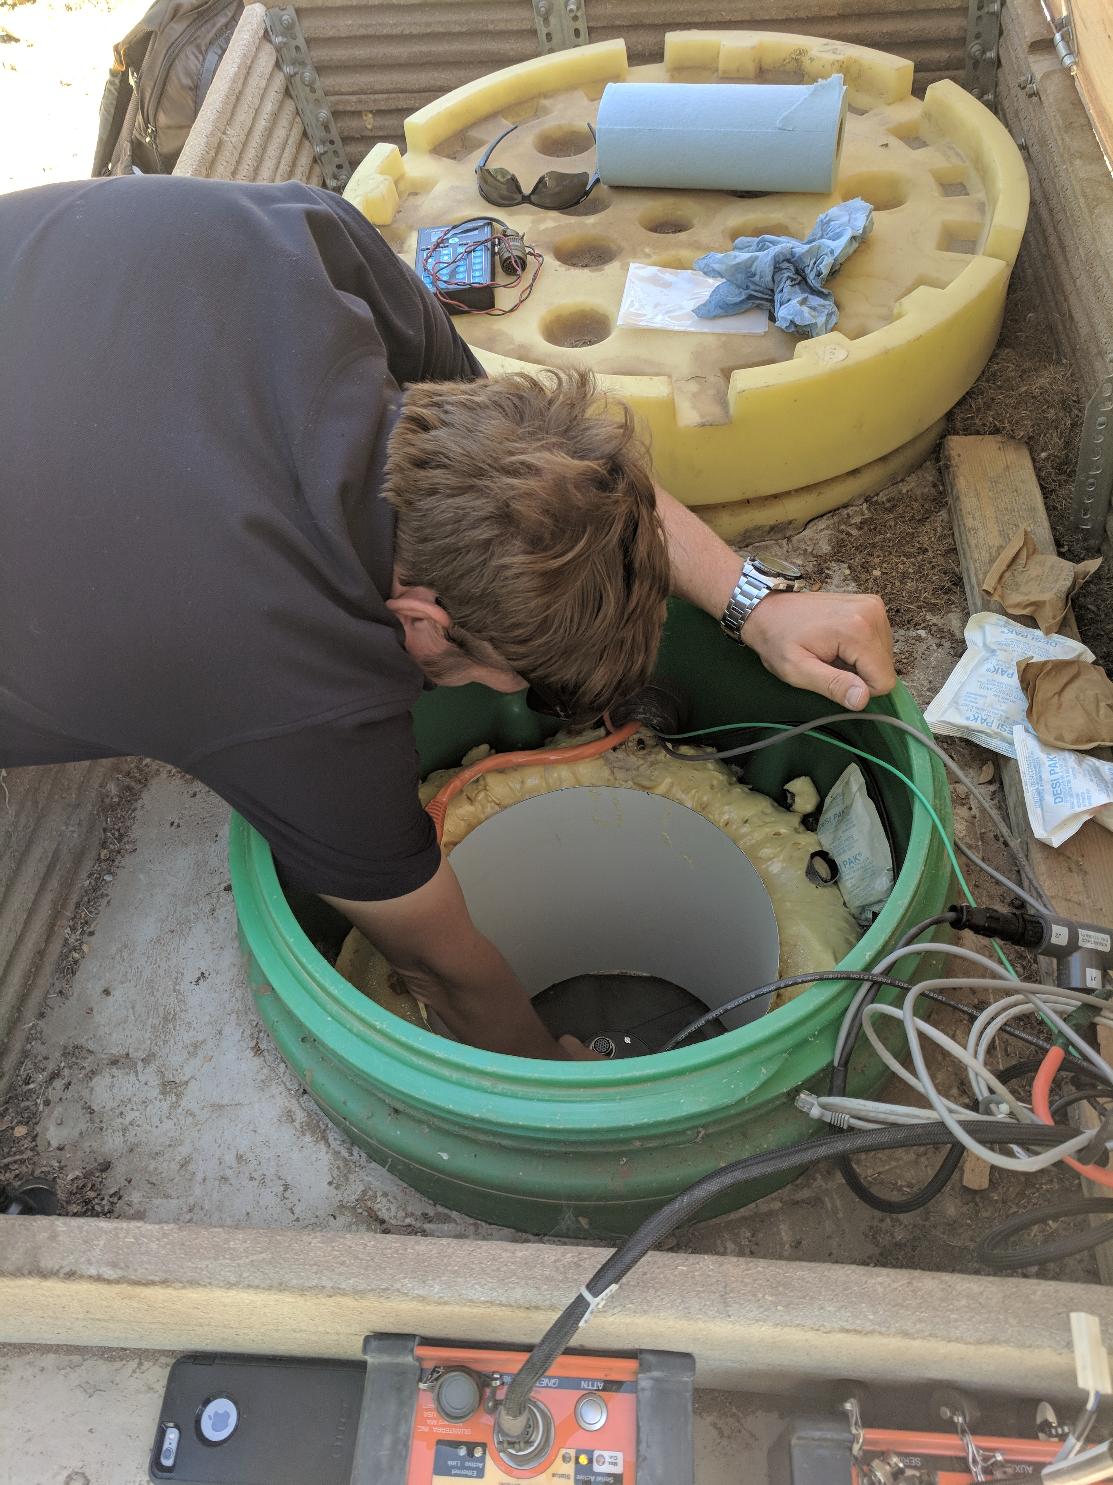
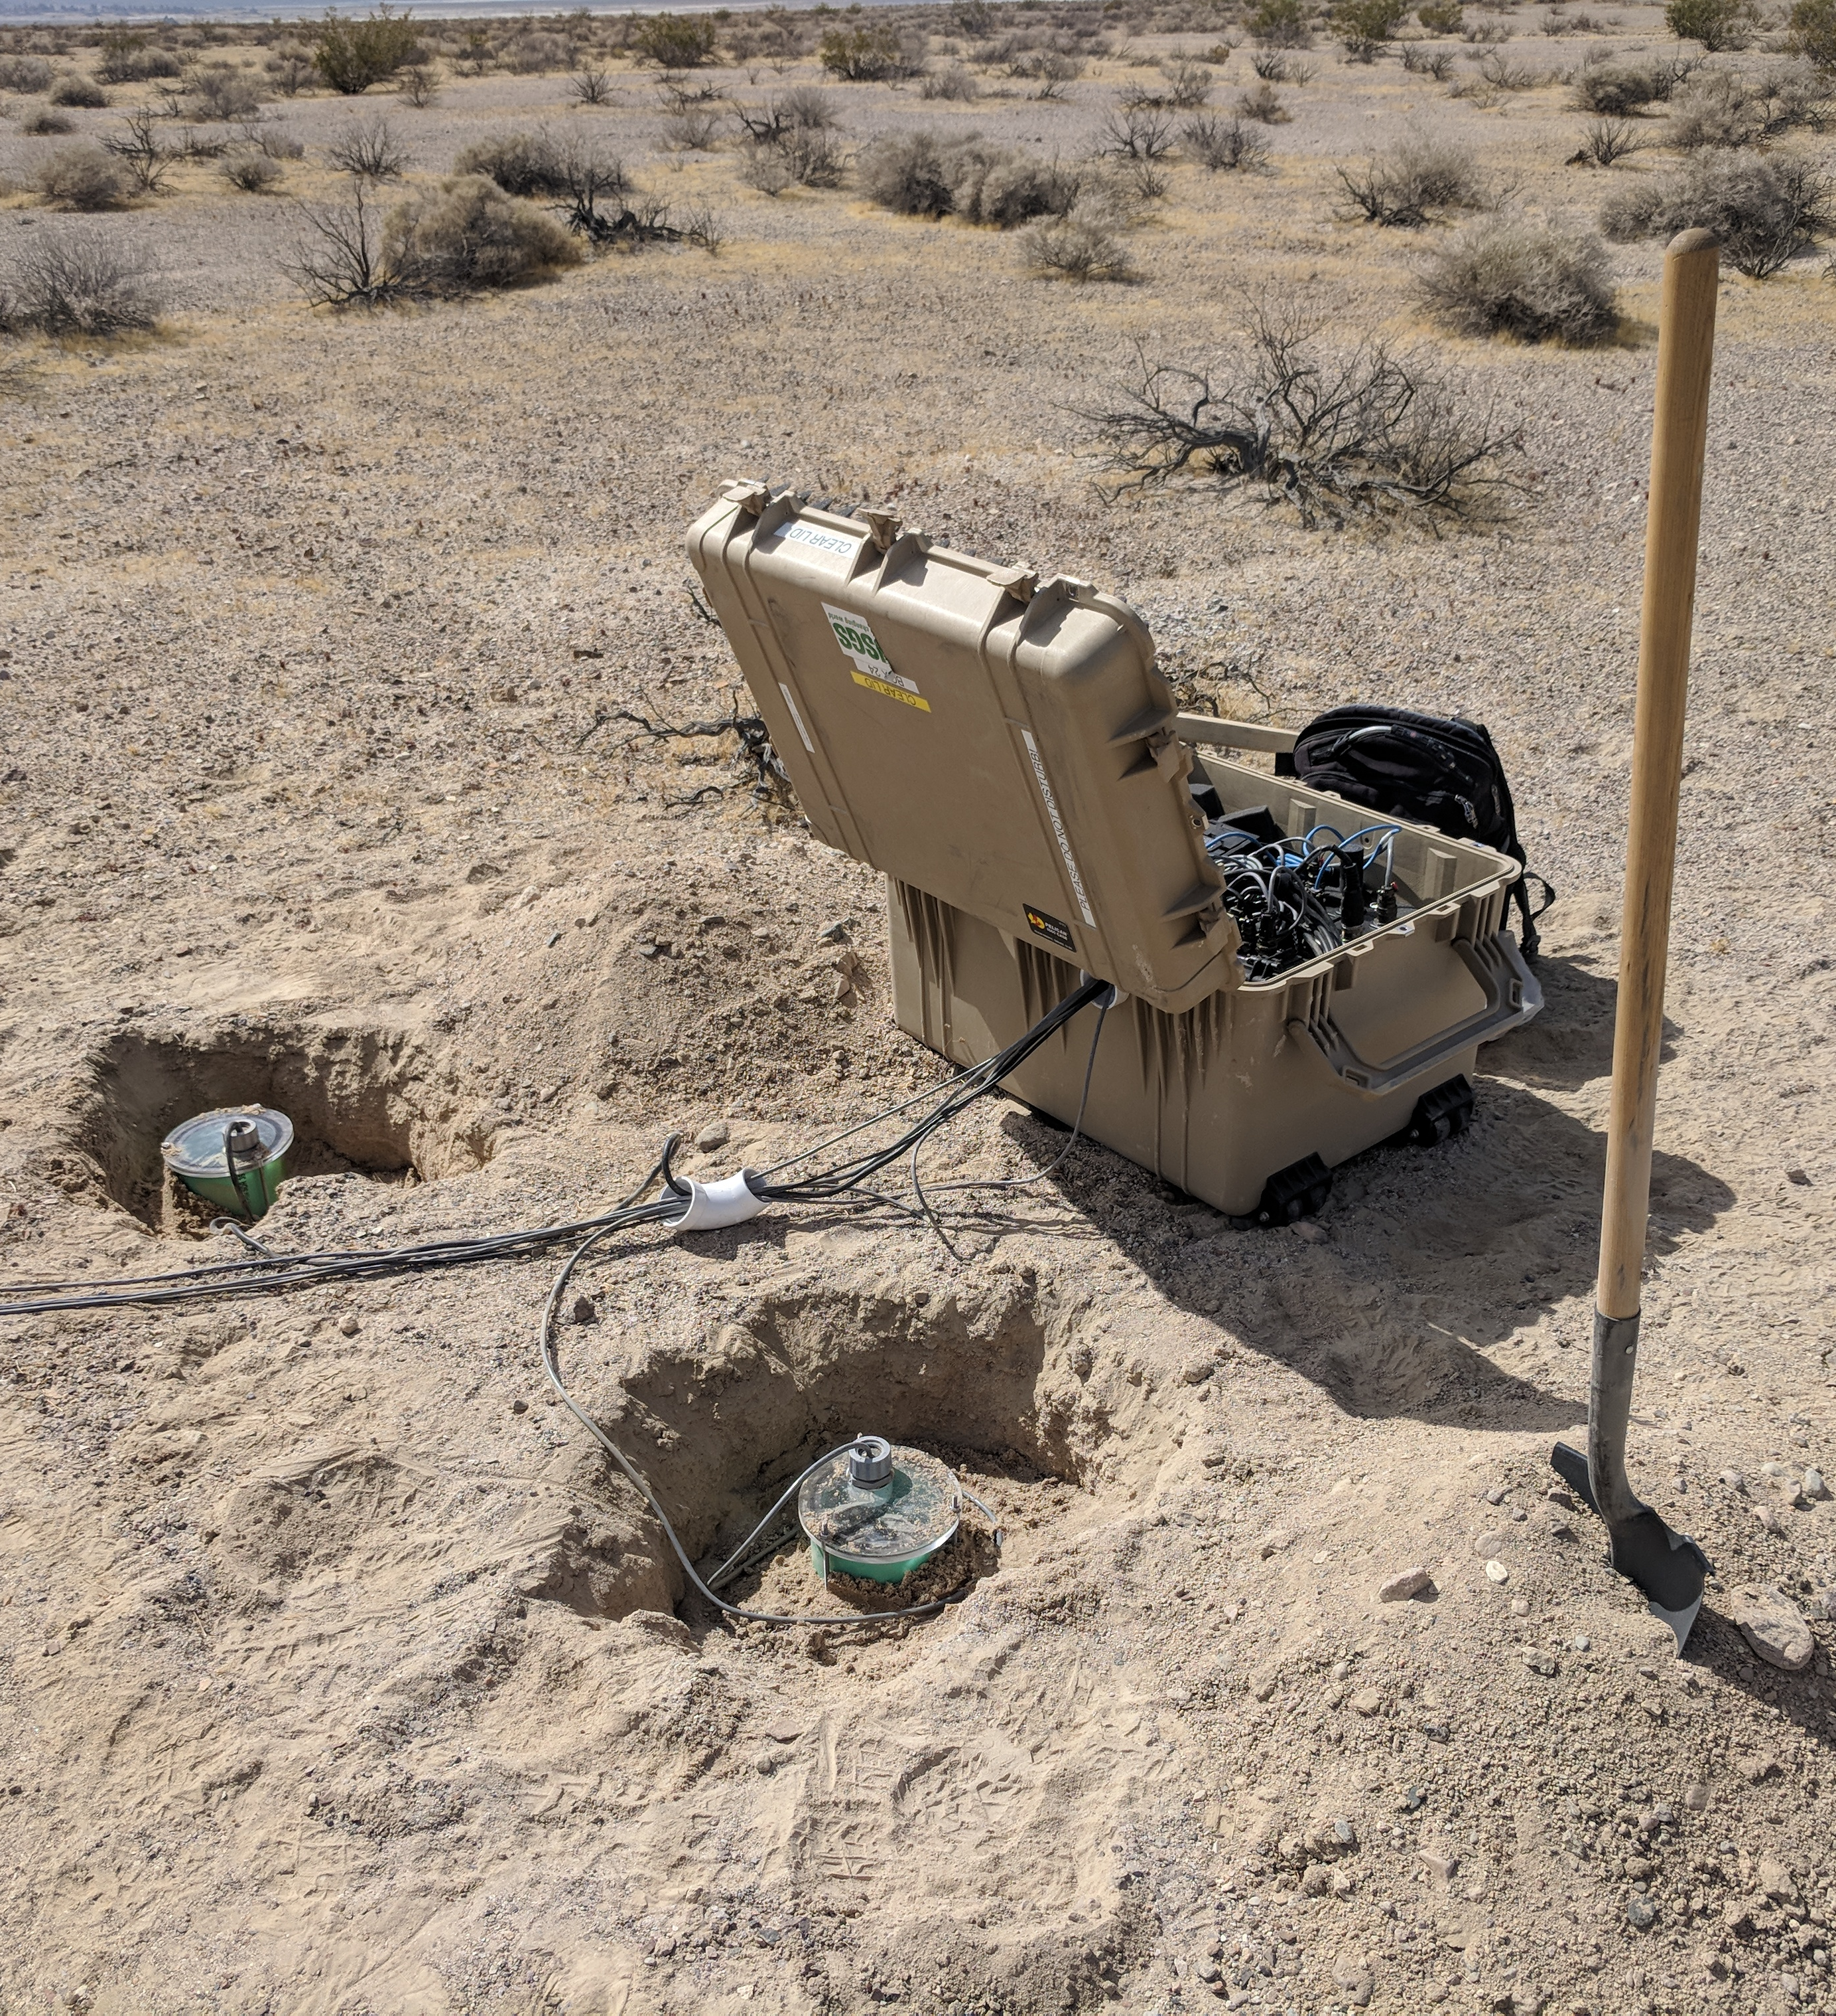
Global Seismographic Network:
Highest-quality, long-term observations for research and monitoring
Special emphasis on long-period data (T>100 s)
Global coverage
ANSS backbone network:
Monitor M≥2.5 earthquakes inside United States
Provide uniform coverage across the lower 48, fill gaps between denser regional networks
Portable stations:
Rapid response to significant earthquakes
Densify coverage to improve estimates of earthquake location and depth
Record near-source strong ground motions for hazard studies
Notes:
three examples of different kinds of stations with different instrumentation

Slide 6
Outline
What is an instrument response?
Very brief overview of noise sources
Self-noise and instrumentation limitations
Follow up on questions from last week: channel naming
Exercise: removing instrument responses in ObsPy!

Slide 7
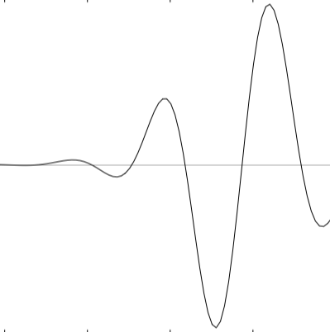
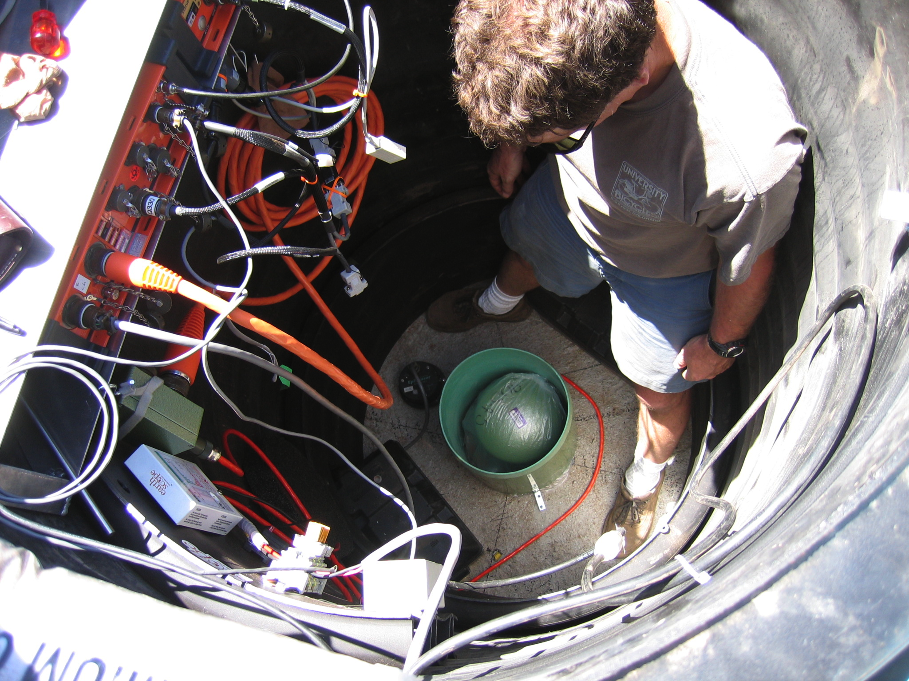
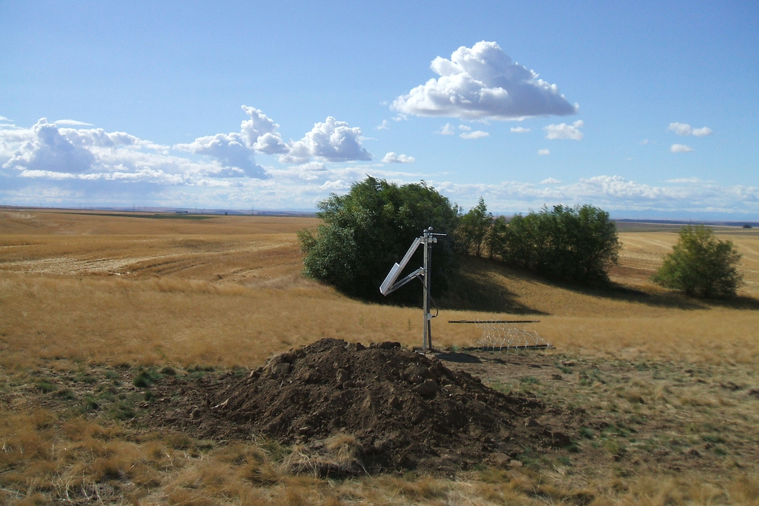
From Earth to Your Desktop
mechanical response
(poles and zeroes)
ground motion
electrical response
(“gain factor”)*
seismometer
AD response
(FIR filters)
volts
digitizer/ datalogger
counts
miniSeed
data acquisition
miniSeed & metadata
data management center
waveforms
metadata
Notes:
assumed linear – small non-linearities ignored
allowable for feedback seismometers.

Slide 8
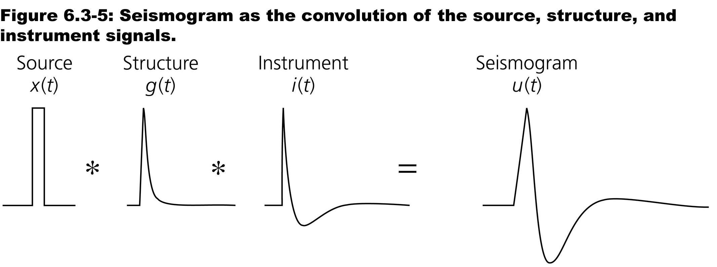
Stein & Wysession (2003)

Slide 9
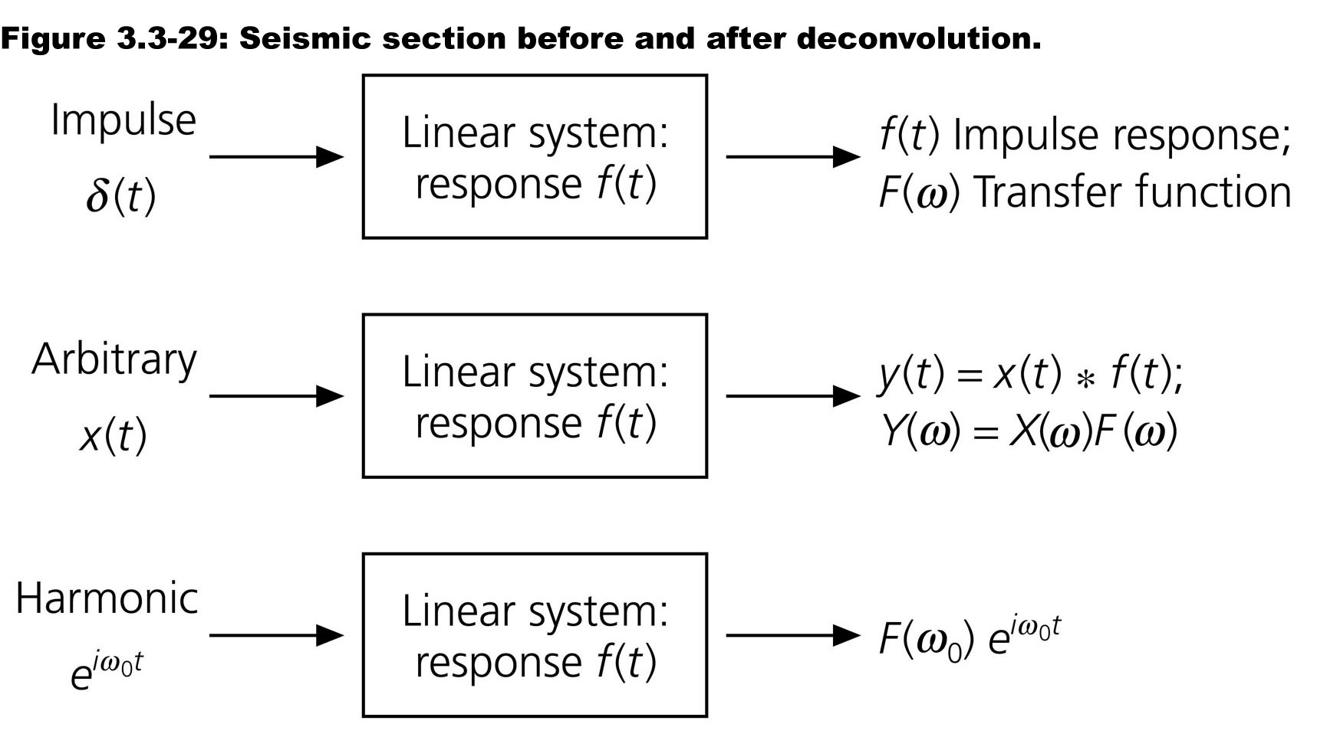
Stein & Wysession (2003)
Notes:
Should really be sources (plural) because of course a seismometer records *any* earth shaking

Slide 10
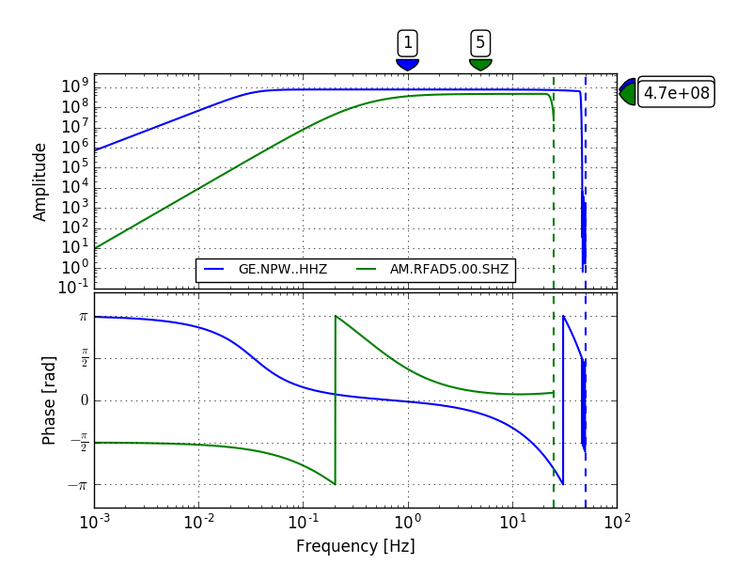
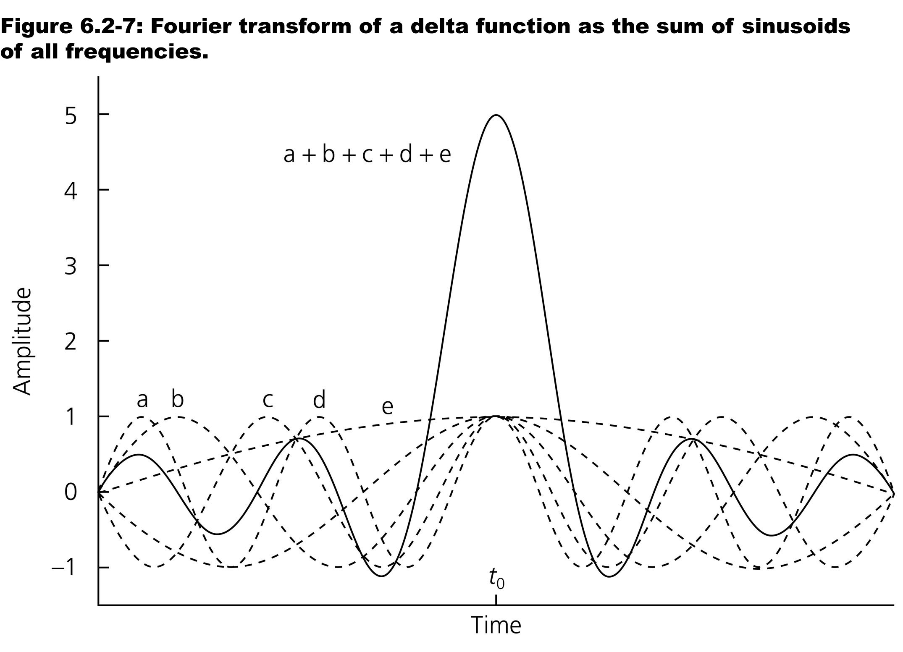
What is an instrument response?

Slide 11
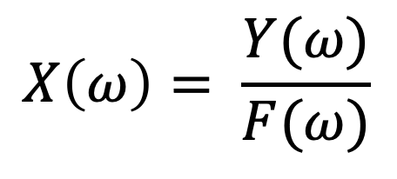
so to remove the response and get a seismogram in units of ground motion…
$$X\left(ω\right)= \frac{Y(ω)}{F(ω)}$$
Output signal (seismogram in counts)
Input signal (ground motion)
=
Instrument response

Slide 12
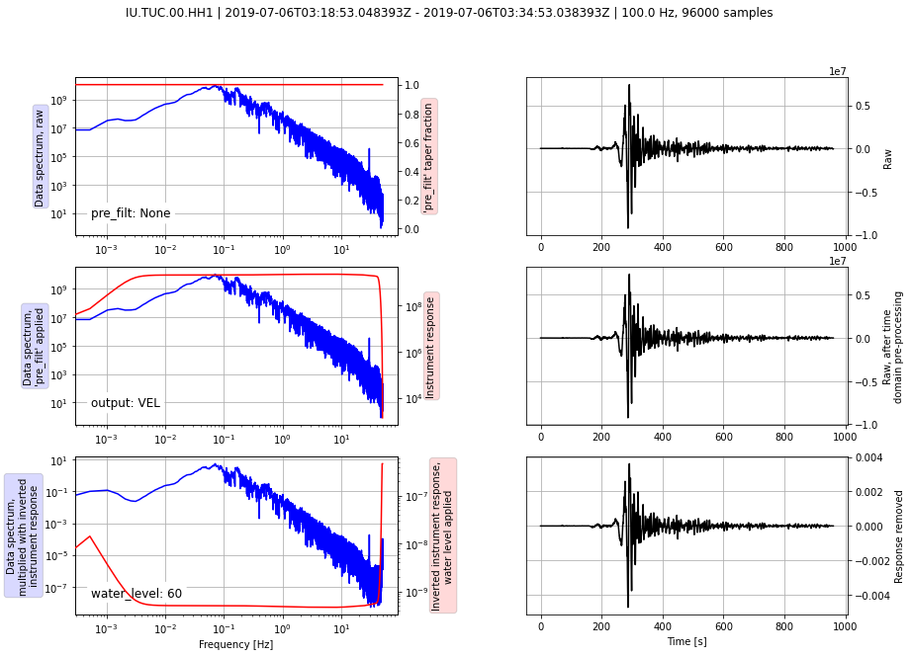
Removing instrument responses: Example from Unit 1
Deconvolving instrument response = division in frequency domain
Note that the amplitude response rolls off toward zero at low and high frequencies – deconvolution needs to be done in a way that avoids dividing by small numbers.
You will explore this later in the exercise!
(In reality, we are working with complex quantities, but it’s helpful to visualize using just the amplitude spectra.)
wait a minute, what’s going on here?

Slide 13
From Earth to Your Desktop
mechanical response
(poles and zeroes)
ground motion
electrical response
(“gain factor”)*
seismometer
AD response
(FIR filters)
volts
digitizer/ datalogger
counts
miniSeed
data acquisition
miniSeed & metadata
data management center
waveforms
metadata
Notes:
assumed linear – small non-linearities ignored
allowable for feedback seismometers.

Slide 14
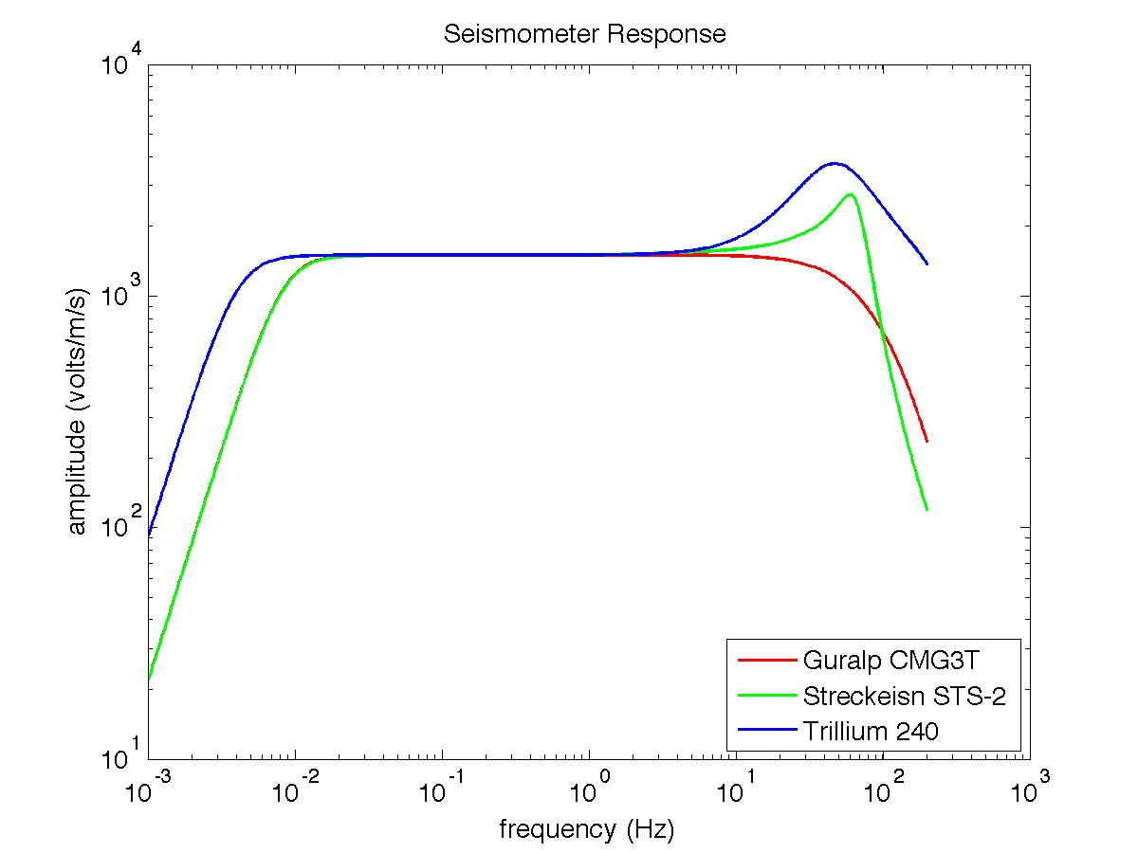
Three types of seismometers used within TA
Seismometer response specified by poles and zeros
For other sensors, check out the IRIS Nominal Response Library: http://ds.iris.edu/NRL/

Slide 15
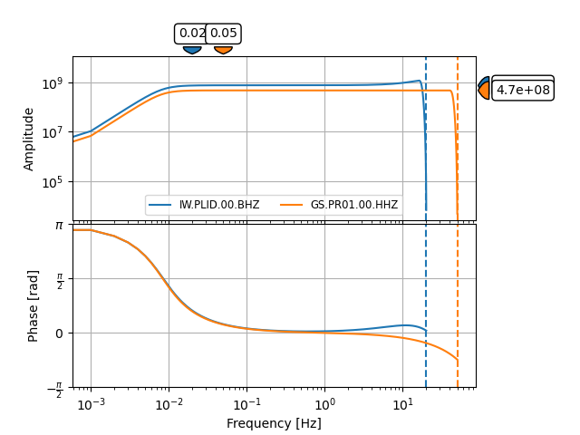
Obtain and plot a response object with ObsPy
import obspy
from obspy.clients.fdsn import Client
client = Client("IRIS")
t1 = obspy.UTCDateTime(‘2020-07-01’)
inv = client.get_stations(network="IW", station="PLID", channel="BHZ", level="response", starttime=t1)
inv += client.get_stations(network="GS", station="PR01", channel="HHZ", level="response", starttime=t1)
inv.plot_response(min_freq=1e-3)
inv.write(‘inventory.xml’, format=‘stationxml’)

Slide 16
Metadata formats
StationXML, SEED (dataless, RESP), SAC PZ
move toward StationXML: human-readable, more flexibility, more info about equipment (if operator supplies it)
Open inventory.xml in your preferred text editor and identify stages of the response:
Seismometer (conversion from ground motion to volts, poles and zeros, sensor gain)
Digitizer (conversion from volts to counts, digitizer gain)
FIR filters (digitizer antialiasing – may be several rounds of these!)
Question from earlier chat: how do I tell if a response is specified in units of velocity, acceleration, etc?
Response is usually specified in the sensor’s “native” units: broadband = velocity, accelerometer = acceleration… but not always. Check the response!

Slide 17
The signal processing chain
High initial sample rate - no anti-alias filtering
Cascade of Finite Impulse Response (FIR) filters
Provide anti-alias low-pass filters
Each low-pass followed by decimation
seismometer
analog signal (volts)
digitization
5120 sps
(counts)
anti-alias FIR filter & decimate
320 sps
anti-alias FIR filter & decimate
80 sps
anti-alias FIR filter & decimate
40 sps
BHZ @ 40 sps

Slide 18
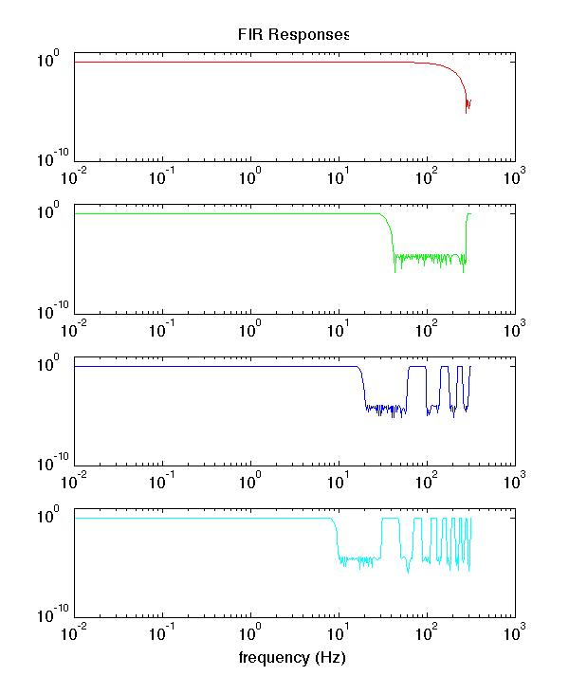
FIR Cascade
Combined effect of FIR cascade prevents aliasing
sample at 320 sps after filtering
sample at 80 sps after filtering
sample at 40 sps after filtering
sample at 20 sps after filtering

Slide 19
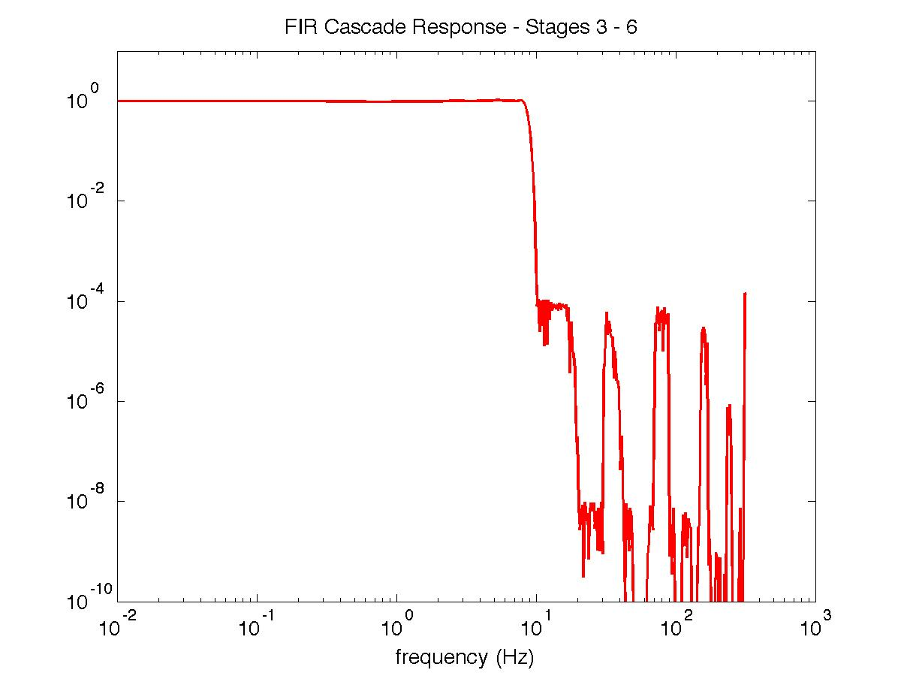
FIR Cascade - Cumulative Response
Response shown for final BH channel sampled at 20 sps

Slide 20
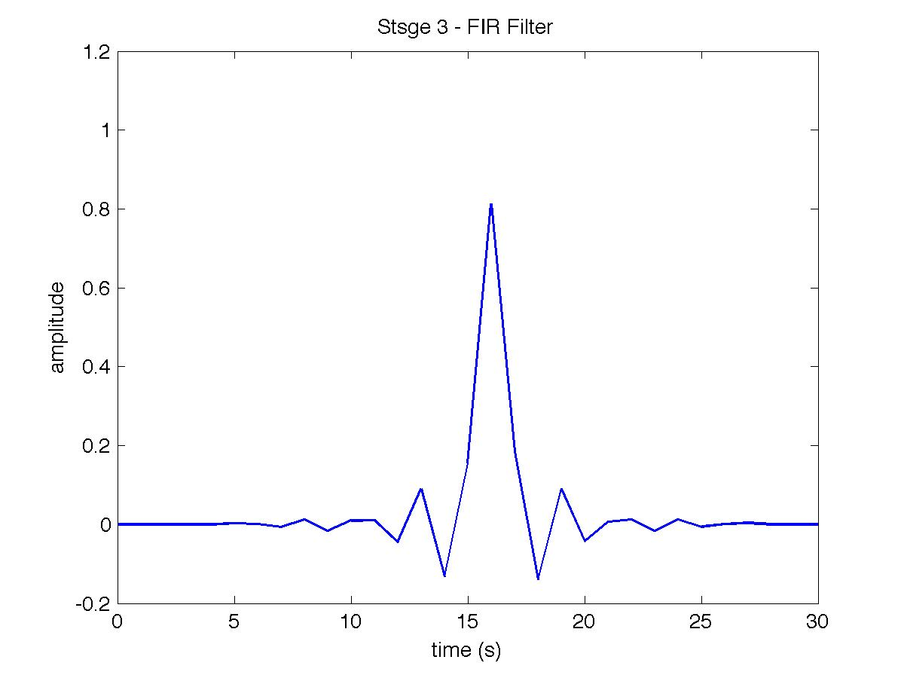
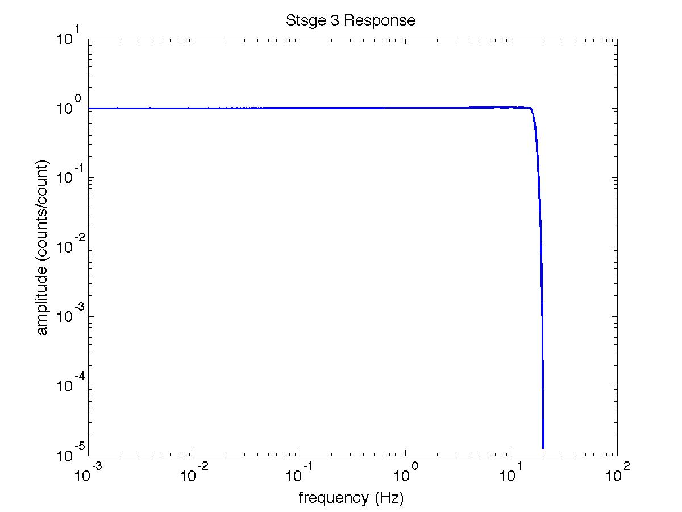
The TA: Composite FIR Filter
Represent the entire FIR filter cascade with a single filter
Seed provides time domain representation
Time Domain Representation
Frequency Response

Slide 21
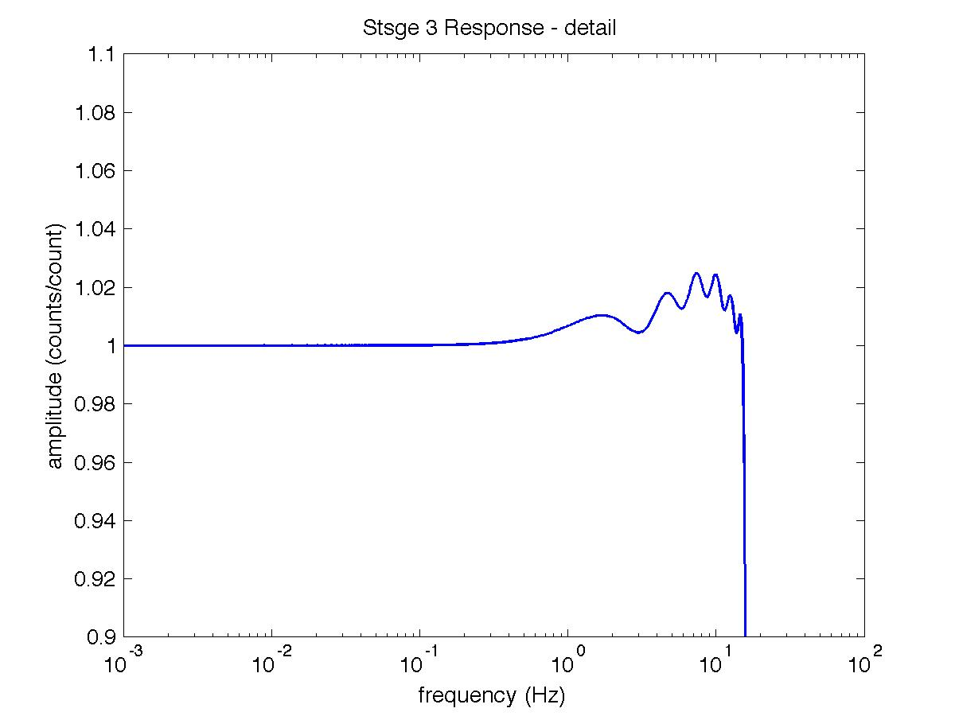
FIR Filter Ripple
Ripple near Nyquist Frequency
Ripple is less than 5%
Nyquist Frequency = half of sampling frequency

Slide 22
Recap on FIR Filters
What are they used for?
Low-pass anti-alias ﬁltering
When can you ignore them?
When working at frequencies reasonably* below the Nyquist frequency
What are their side-eﬀects?
Slight rippling (in amplitude) near Nyquist frequency
Acausal ringing for sharp onsets (ringing is at frequencies near Nyquist)
What can be done about the side-eﬀects?
Knowledge is power - steer clear of side-eﬀects
My personal practice:
max frequency analyzed should be no higher than 50-75% of Nyquist (i.e., 10-15 Hz for data sampled at 40 samples per second)
just do the full deconvolution!
Notes:
reasonably means:
if fNyq = 20 Hz (sps = 40 Hz)
10 Hz at 2+ % accuracy
2 Hz at 1- % accuracy
0.5 Hz at “fraction of a” % accuracy

Slide 23
Outline
What is an instrument response?
Very brief overview of noise sources
Self-noise and instrumentation limitations
Follow up on questions from last week: channel naming
Exercise: removing instrument responses in ObsPy!

Slide 24
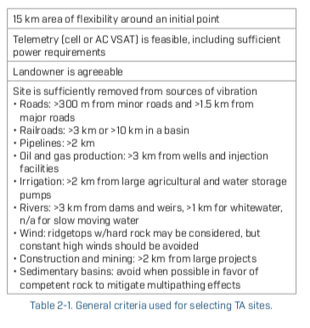
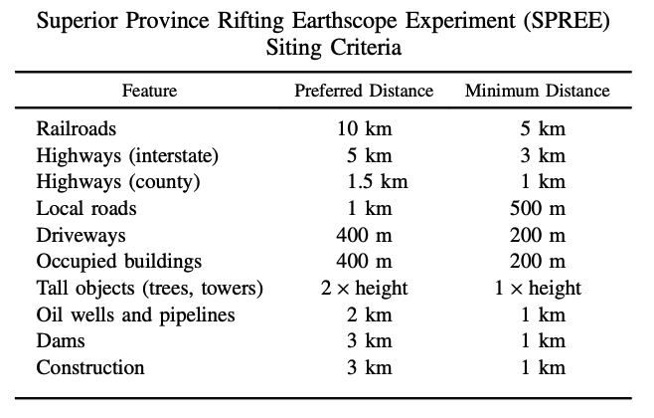
Seismometers record signals from many sources
SPREE portable deployment (Wolin et al., 2015)
Transportable Array (Busby et al., 2018)

Slide 25
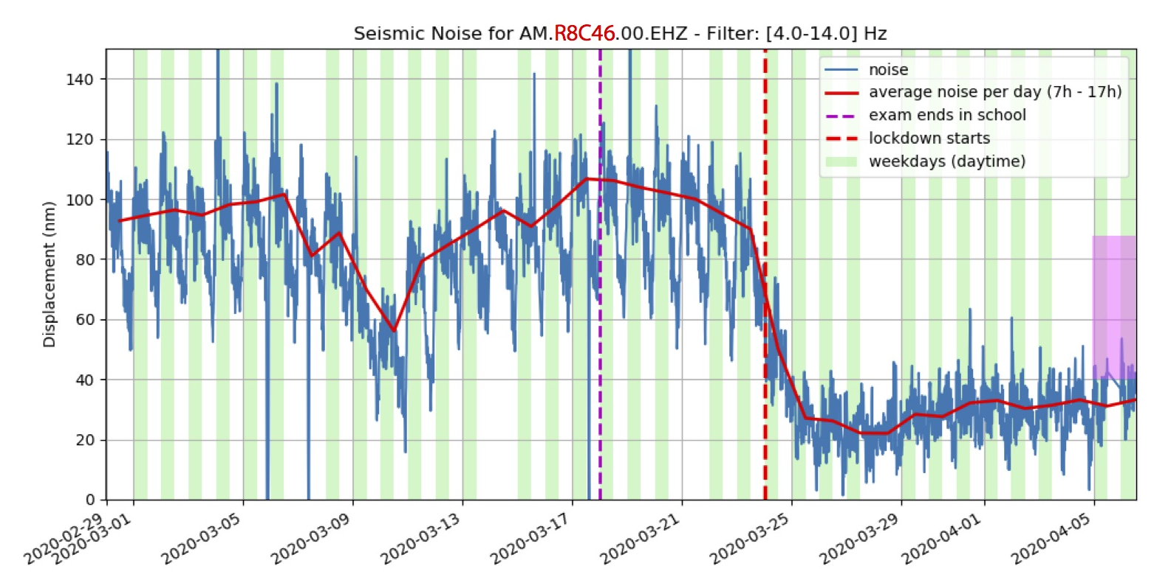
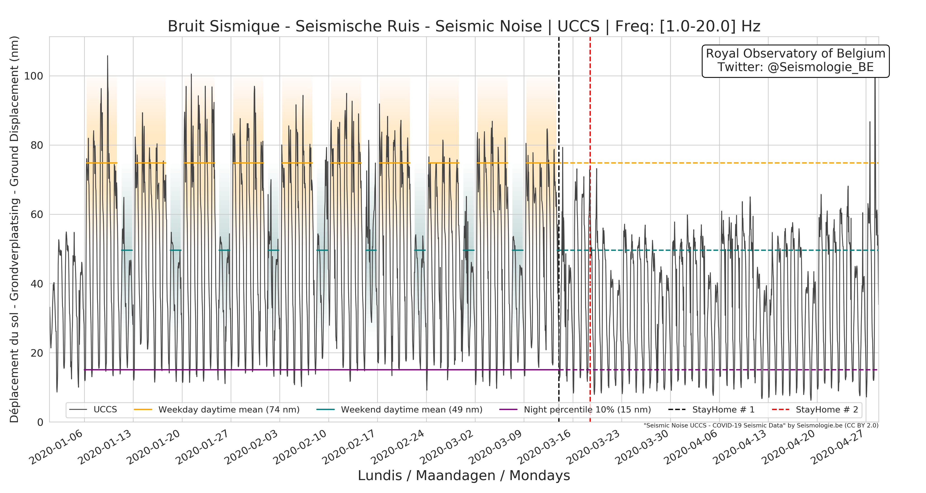
Drop in “cultural” noise levels due to covid-19 lockdowns
Raspberry Shake installed in a school in Nepal
(@AtSeismo/Shiba Subedi)
Permanent broadband in Brussels
(@Seismologie_be/@seismotom/Thomas Lecoq)

Slide 26
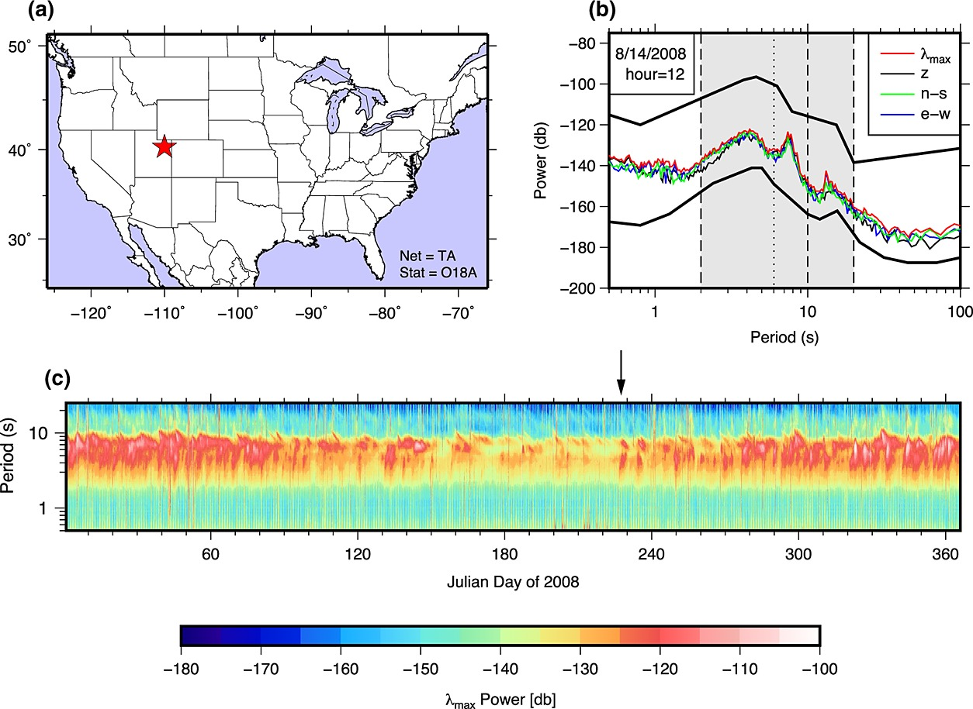
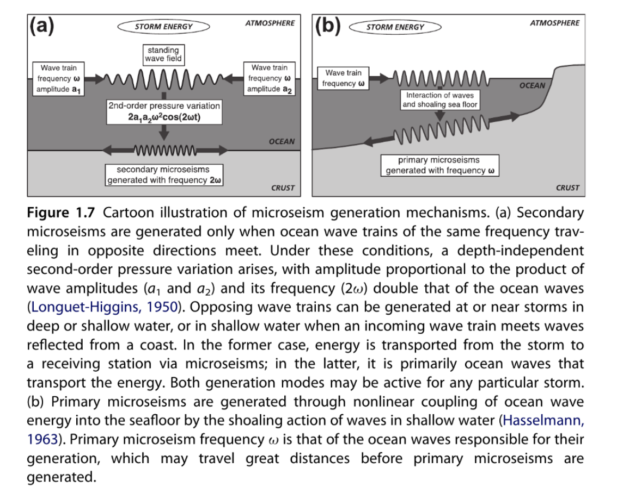
Seismometers record signals from many sources
Ocean storms – including hurricanes
(Koper and Burlacu, 2015)
(Ebeling, 2012)

Slide 27
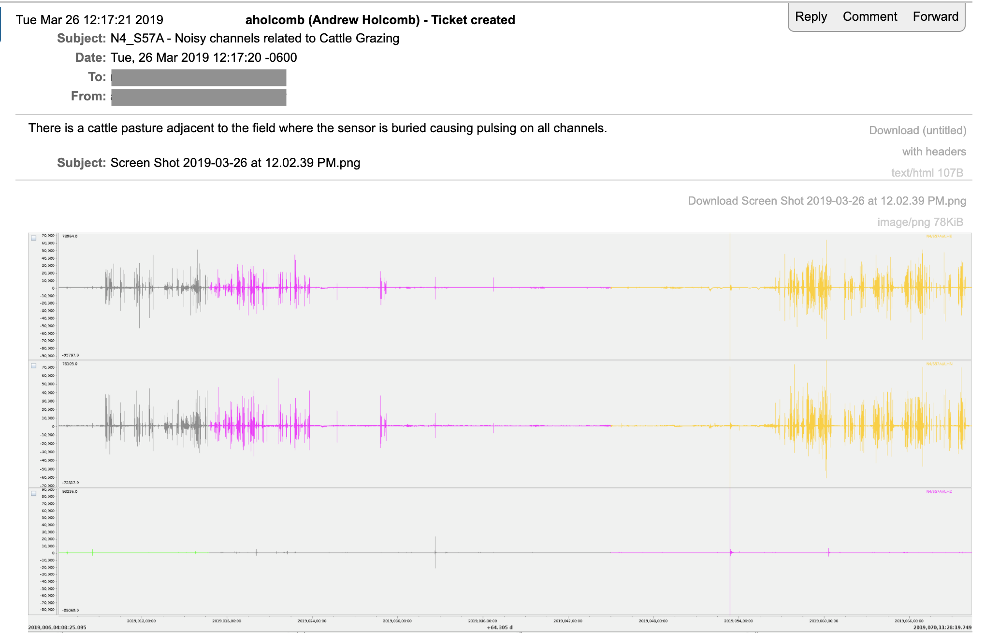

Long-period signals from surface tilt

Slide 28
Long-period signals from surface tilt
Passage of storm front over TA stations:
large tilt signal coincides with passage of gust front (initial pressure jump)
Tytell et al. (2011)
Vernon et al. (2011)

Slide 29
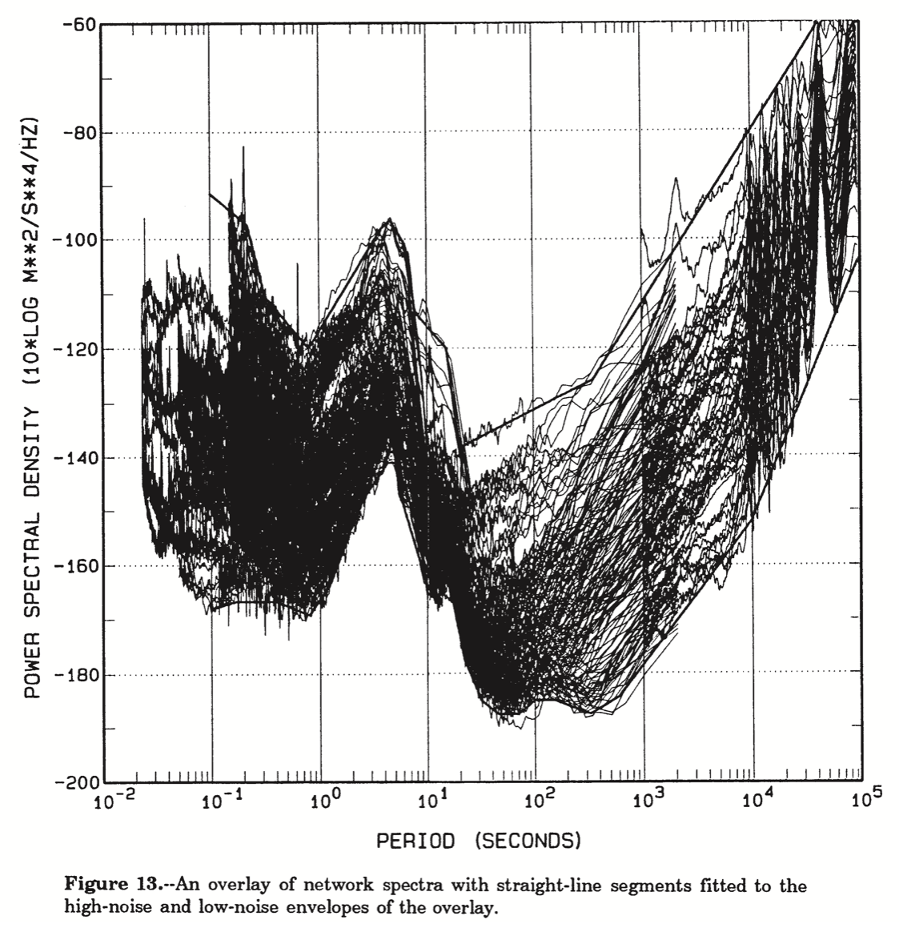
PSDs, PDFs, and noise models
Peterson (1993) noise models widely used to assess station performance
Defined by range of power spectra observed at high-quality permanent network sites
“New” High and Low Noise models (NHNM, NLNM)

Slide 30
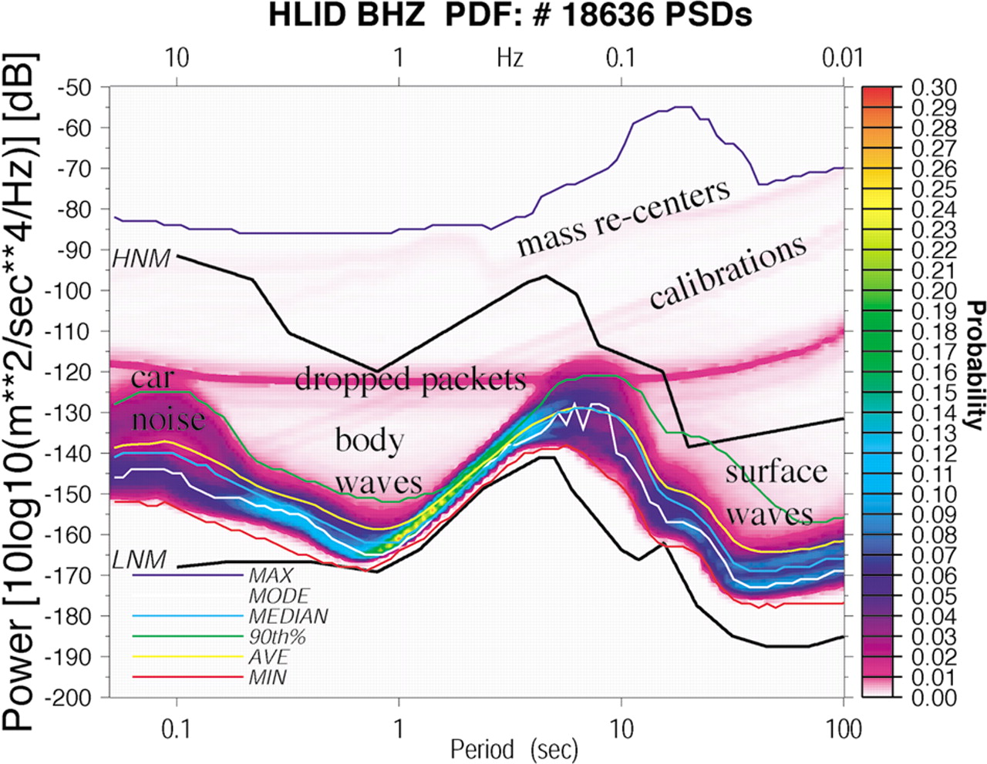
PSDs, PDFs, and noise models
Power spectral density (PSD) probability density functions (PDFs) show distribution of noise in a given time period
Slice seismogram into many overlapping segments, calculate power spectra, create 2D histogram of power vs. frequency
Widely used in network quality control
Choice of processing parameters matters! Tune carefully to avoid biasing or smoothing through signals of interest (Anthony et al., 2018)
(McNamara and Buland, 2004)

Slide 31
PSDs, PDFs, and noise models
short
microseismic
long
0.1-1 s
1-10 Hz
1-20 s
0.05-1 Hz
> 20 s
< 0.05 Hz
Human activity
Ocean storms
Local site response to atmospheric & thermal variations
At T > 20 s, horizontal components are usually noisier than verticals due to local tilt effects
Horizontal noise decreases with increasing depth of installation
Noise mitigated by:
Site selection
Not much!
Construction

Slide 32
Outline
What is an instrument response?
Very brief overview of noise sources
Self-noise and instrumentation limitations
Follow up on questions from last week: channel naming
Exercise: removing instrument responses in ObsPy!

Slide 33
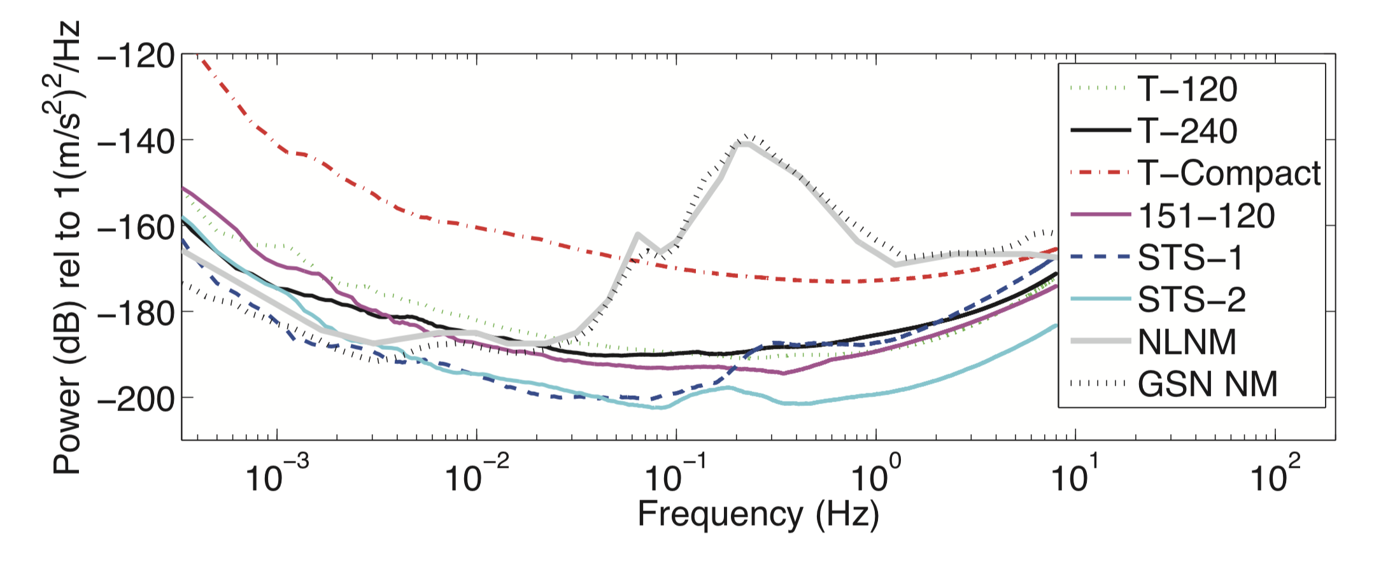
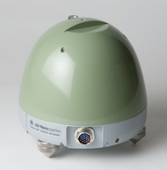
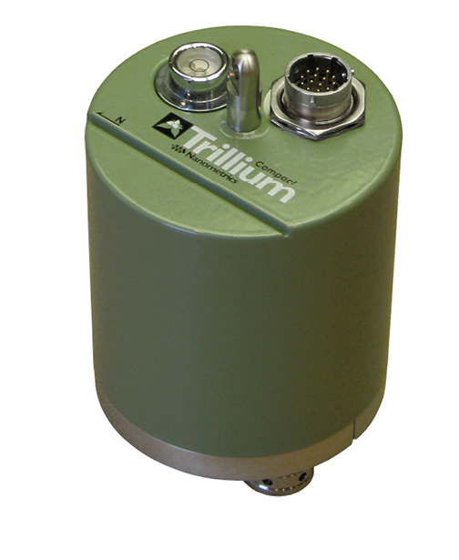
Self-noise
Defined by instrument + digitizer
Smallest resolvable signal based on limits of instrumentation
Instruments can have the same response shape but different self-noise levels!
example: Trillium 120 vs Trillium Compact 120
Trillium 120
Trillium Compact
smaller masses in TC120 = higher self-noise at long periods!
Hutt and Ringler (2010)

Slide 34
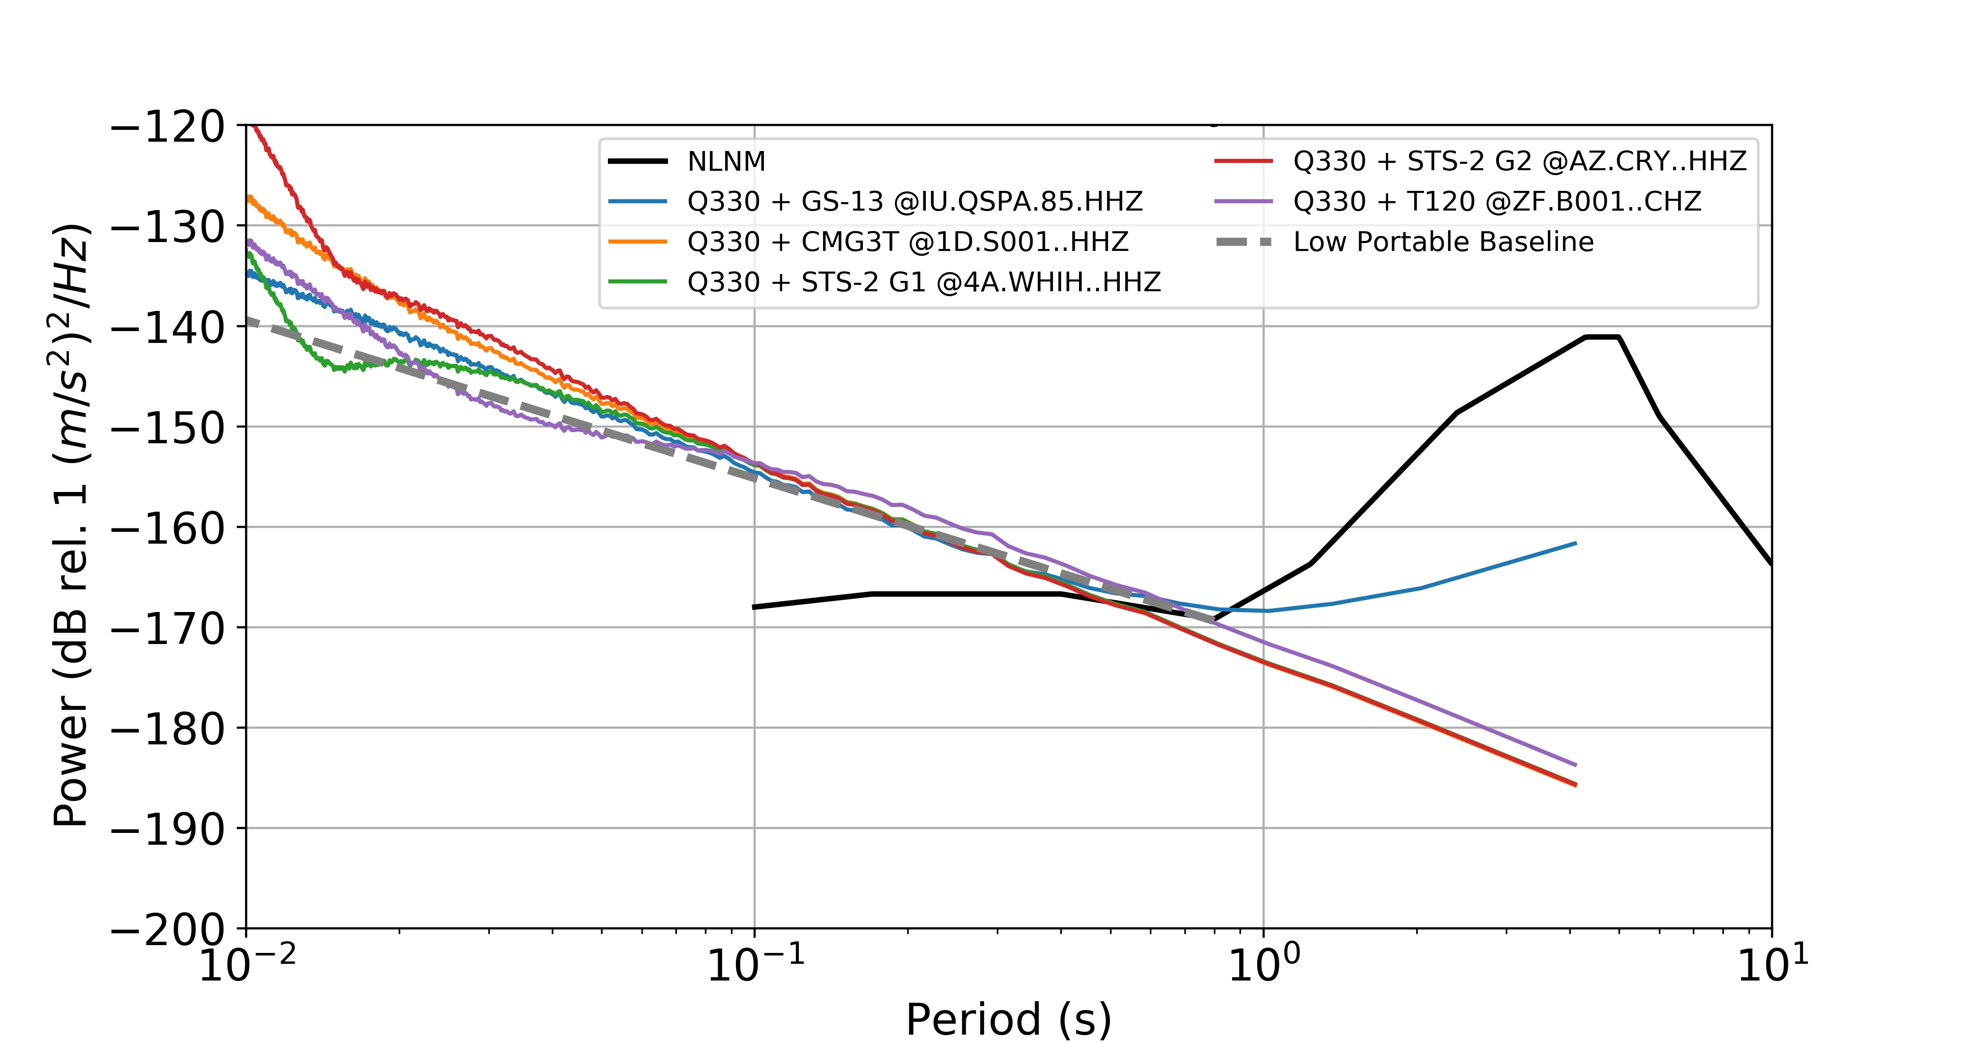
Self-noise
Example: the lowest noise levels recorded by the TA are defined by the instrument + digitizer self-noise floor, NOT physical ground motion
Tradeoff between self-noise and dynamic range: can use higher-gain sensors and/or 26-bit digitizers to detect smaller signals, but this lowers the clip threshold
(Wolin and McNamara, 2019)

Slide 35
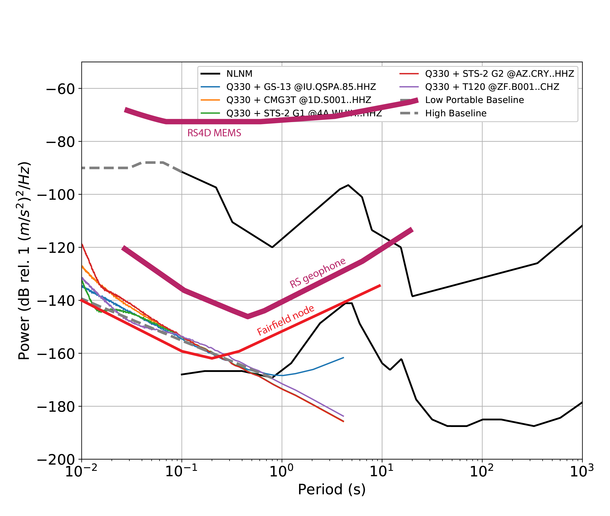
Self-noise
If you’re used to working with data from permanent broadband sensors, you may not think much about self-noise
Short-period systems (geophones, nodes) and accelerometers – especially MEMS – have self-noise that is much higher than a typical observatory-grade broadband sensor + digitizer
Know the limitations of your instruments!

Slide 36
Outline
What is an instrument response?
Very brief overview of noise sources
Self-noise and instrumentation limitations
Follow up on questions from last week: channel naming
Exercise: removing instrument responses in ObsPy!

Slide 37
Channel naming conventions
Orientation: why use Z, 1, 2 instead of Z, N, E components?
Some stations are deployed in situations where they cannot be oriented to true North
Posthole or borehole
Ocean-bottom seismometer
Have you ever installed a station and later realized its orientation was incorrect?
Best practice: use orientation specified in metadata instead of assuming orientation based on channel name
Determining TA orientations:
Ekström, G., and M. Nettles, 2018, Observations of seismometer calibration and orientation at USArray stations, 2006–2015, Bulletin of the Seismological Society of America, doi: https://doi.org/10.1785/0120170380
Ekström, G., and R.W. Busby, 2008, Measurements of seismometer orientation at USArray Transportable Array and Backbone stations, Seismological Research Letters, doi: https://doi.org/10.1785/gssrl.79.4.554

Slide 38
Channel naming conventions
Interpreting channel codes:
Sensor proportional to velocity (usually broadband),
Vertical component,
sampled at 1 Hz
L
H
Z
1st letter: sample rate
H = 80-250 samples/sec
B = 10-80 sps
L = 1 sps
V = 1 sample/10 sec
2nd letter: instrument type
H = high-gain seismometer
(resp proportional to velocity)
N = accelerometer
3rd letter: orientation
N = north
E = east
Z = vertical
1, 2 = arbitrary horizontals
https://ds.iris.edu/ds/nodes/dmc/tools/data_channels/

Slide 39
Channel naming conventions
Interpreting channel codes:
Accelerometer,
horizontal component,
sampled at 100 Hz
H
N
1
1st letter: sample rate
H = 100 samples/sec
B = 40 sps
L = 1 sps
2nd letter: instrument type
H = high-gain seismometer
(resp proportional to velocity)
N = accelerometer
3rd letter: orientation
N = north
E = east
Z = vertical
1, 2 = arbitrary horizontals
https://ds.iris.edu/ds/nodes/dmc/tools/data_channels/

Slide 40
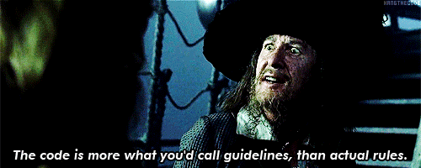
Channel naming conventions
Interpreting channel codes:
Accelerometer,
East component,
sampled at 100 Hz
H
N
E
When in doubt,
INSPECT THE RESPONSE
1st letter: sample rate
H = 100 samples/sec
B = 40 sps
L = 1 sps
2nd letter: instrument type
H = high-gain seismometer
(resp proportional to velocity)
N = accelerometer
3rd letter: orientation
N = north
E = east
Z = vertical
1, 2 = arbitrary horizontals
https://ds.iris.edu/ds/nodes/dmc/tools/data_channels/

Slide 41
Exercise: Obtain and remove instrument response
Processing parameters should be chosen based on instrumentation used and frequency band of interest for your study.
Open-ended lab: experiment with pre_filt, water_level, taper, and zero_mean parameters
How do different pre_filt and water_level parameters affect the output?
What happens if you add an offset or trend to your data and don’t taper or remove the mean?
Obtain data for your station and signals of interest
If you want more: try computing PSD PDFs for a station of interest to you following the ObsPy tutorial: https://docs.obspy.org/tutorial/code_snippets/probabilistic_power_spectral_density.html

